Slide 1
6. Continuous Random Variables I

Slide 2


Delivery time
A package is to be delivered between noon and 1pm.
What is the expected arrival time?

Slide 3
Discrete model I
Ω = {0, 1, …, 59}
equally likely outcomes
X: minute when package arrives

Slide 4
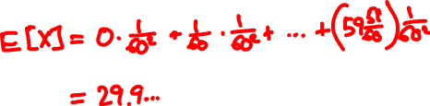
Discrete model II
Ω = {0, , , …, 1, 1 , …, 59 }
1
2
1
59
60
60
60
60
equally likely outcomes
X: minute when package arrives

Slide 5

Continuous model
Ω = the (continuous) interval [0, 60)
equally likely outcomes
X: minute when package arrives

Slide 6
Uncountable sample spaces
In Lecture 2 we said:
“The probability of an event is the sum of the
probabilities of its elements”
but in [0, 60) all elements have probability zero!
To specify and calculate probabilities, we have to work with the axioms of probability

Slide 7
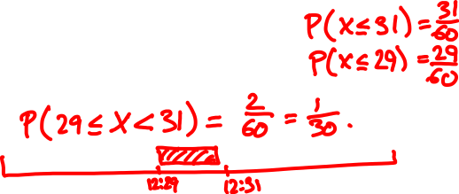
The uniform random variable
Sample space Ω = [0, 60)
Events of interest:
intervals [x, y) ⊆ [0, 60)
their intersections, unions, etc.
Probabilities:
P([x, y)) = (y – x)/60
Random variable:
X(ω) = ω

Slide 8
Cumulative distribution function
The probability mass function doesn’t make much sense because P(X = x) = 0 for all x.
Instead, we can describe X by its cumulative distribution function (CDF) F:
F_{X}(x) = P(X ≤ x)

Slide 9
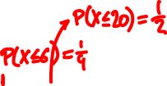
Cumulative distribution functions
f_{X}(x) = P(X = x)
F_{X}(x) = P(X ≤ x)

Slide 10
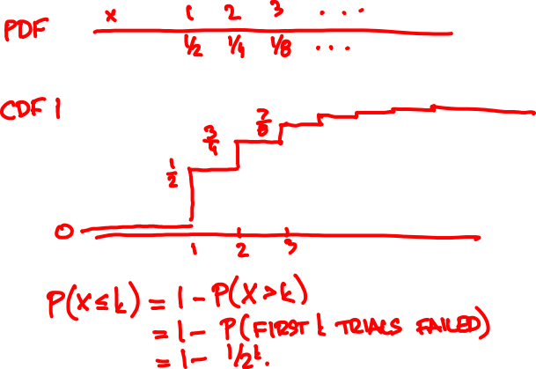

What is the Geometric(1/2) CDF?

Slide 11
Cumulative distribution functions
f(x) = P(X = x)
F(x) = P(X ≤ x)

Slide 12
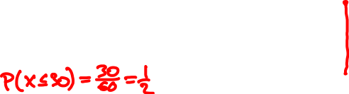
Uniform random variable
If X is uniform over [0, 60) then
X ≤ x
0
x
60
F(x)
0
for x < 0
P(X ≤ x) =
x/60
for x ∈ [0, 60)
1
for x > 60
x

Slide 13
Cumulative distribution functions
discrete CDF F(x) = P(X ≤ x)
PMF f(x) = P(X = x)
?
continuous CDF F(x) = P(X ≤ x)

Slide 14
Discrete random variables:
PMF f(x) = P(X = x)
CDF F(x) = P(X ≤ x)
f(x) = F(x) – F(x – δ)
F(a) = ∑_{x ≤ a} f(x)
for small δ
Continuous random variables:
The probability density function (PDF) of a random variable with CDF F(x) is
F(x) – F(x – δ)
dF(x)
f(x) =
lim
=
δ
dx
δ → 0

Slide 15
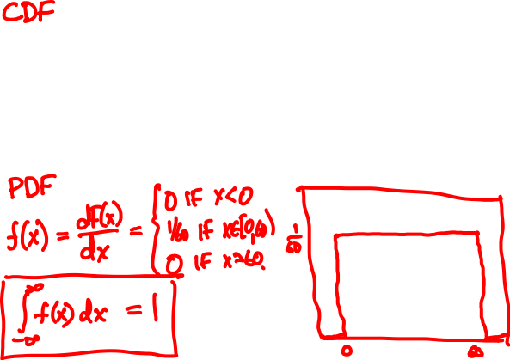
Uniform random variable
0
if x < 0
F(x) =
x/60
if x ∈ [0, 60)
1
if x ≥ 60

Slide 16
Probability density functions
discrete CDF F(x) = P(X ≤ x)
PMF f(x) = P(X = x)
continuous CDF F(x) = P(X ≤ x)
PDF f(x) = dF(x)/dx

Slide 17
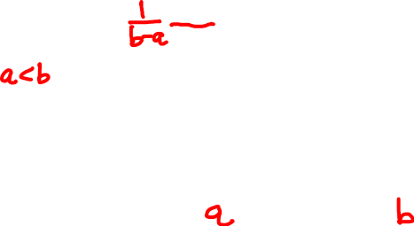
Uniform random variable
The Uniform(0, 1) PDF is
1
if x ∈ (0, 1)
f(x)
f(x) =
0
if x < 0 or x > 1
The Uniform(a, b) PDF is
1/(b - a)
if x ∈ (a, b)
f(x) =
0
if x < a or x > b
X
a
b

Slide 18
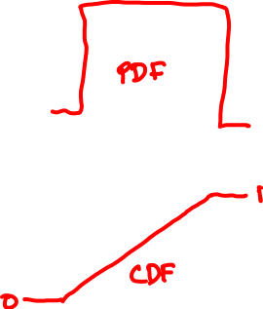
Calculating the CDF
Discrete random variables:
PMF f(x) = P(X = x)
CDF F(x) = P(X ≤ x) = ∑_{x ≤ t} f(t)
Continuous random variables:
PDF f(x) = dF(x)/dx
CDF F(x) = P(X ≤ x) = ∫_{t ≤ x} f(t)dt

Slide 19
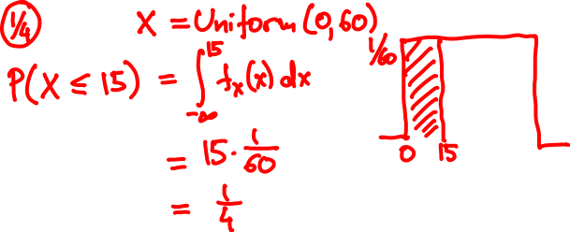
A package is to arrive between 12 and 1
What is the probability it arrived by 12.15?

Slide 20

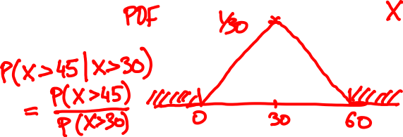


Alice said she’ll show up between 7 and 8,
probably around 7.30.
It is now 7.30. What is the probability
Bob has to wait past 7.45?

Slide 21
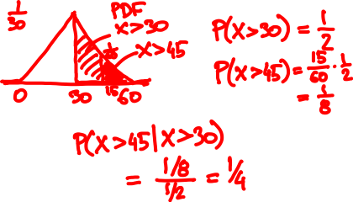

Slide 22
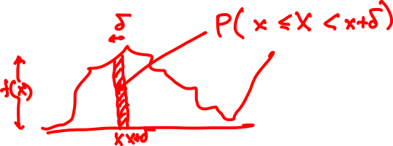
Interpretation of the PDF
The PDF value f(x) δ approximates the probability that X in an interval of length δ around x
P(x – δ ≤ X < x) = f(x) δ + o(δ)
P(x ≤ X < x + δ) = f(x) δ + o(δ)

Slide 23
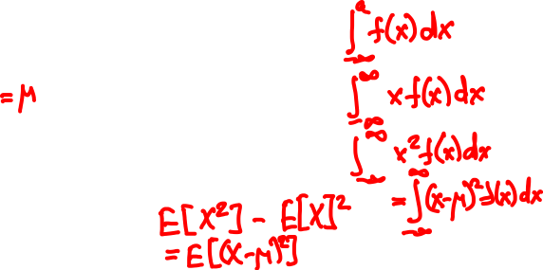
Expectation and variance
PMF f(x)
PDF f(x)
P(X ≤ a)
∑_{x ≤ a} f(x)
E[X]
∑_{x} x f(x)
E[X²]
∑_{x} x² f(x)
Var[X]

Slide 24
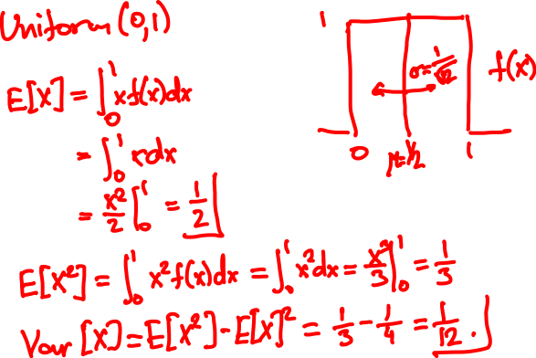
Mean and Variance of Uniform

Slide 25

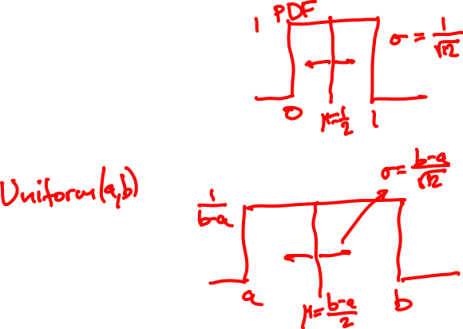

Slide 26


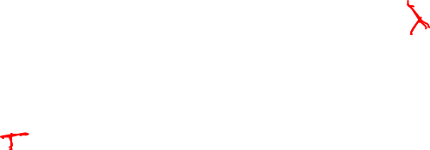
Raindrops again
Rain is falling on your head at an average speed of λ drops/second.
1
2
How long do we wait until the next drop?

Slide 27
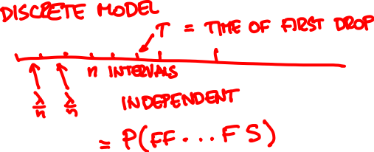

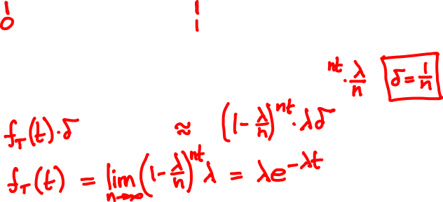


Slide 28
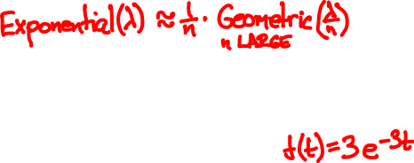
Geometric(3/10)
Geometric(3/100)
Geometric(3/50)
Exponential(3)

Slide 29
The exponential random variable
The Exponential(λ) PDF is
λ e^{-λt}
if x ≥ 0
f(t) =
0
if x < 0.
λ = 1
λ = 1
PDF f(t)
CDF F(t) = P(T ≤ t)

Slide 30
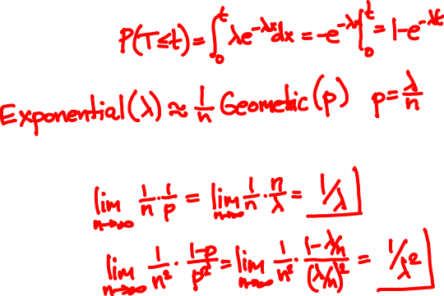
The exponential random variable
CDF of Exponential(λ):
E[Exponential(λ)] =
Var[Exponential(λ)] =

Slide 31
Poisson vs. exponential
N
1
2
T
Poisson(λ)
Exponential(λ)
description
number of events within time unit
time until first event happens
expectation
λ
1/λ
std. deviation
λ
1/λ

Slide 32
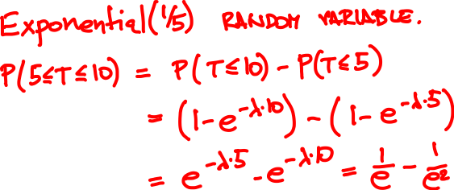
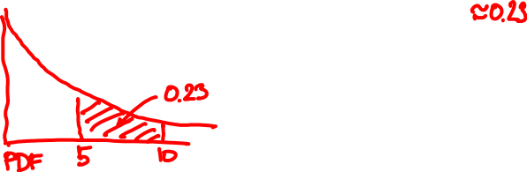
A bus arrives once every 5 minutes. How likely are you to wait 5 to 10 minutes?

Slide 33
Binomial(64, 1/2)
Binomial(1000, 1/2)
Binomial(100, 1/2)
Normal(0, 1)

Slide 34
The Normal(0, 1) random variable
PDF
CDF
f(x) = (2π)^{-½} e^{-x /2}
F(x) = (2π)^{-½} ∫_{t ≤ x} e^{-t /2} dt
²
²
E[Normal(0, 1)] =
Var[Normal(0, 1)] =

Slide 35


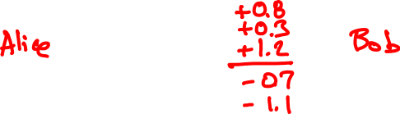


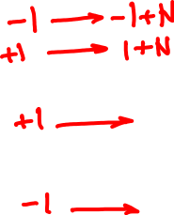


Slide 36
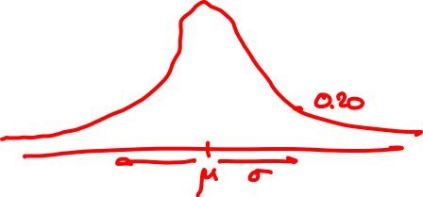


The Normal(μ, σ) random variable
f(x) = (2π)^{–½} e^{– (x – μ) /2σ}
²
²

